Slide 1
D3 (Day 1)
Awesomeness of Data Visualization

Slide 2
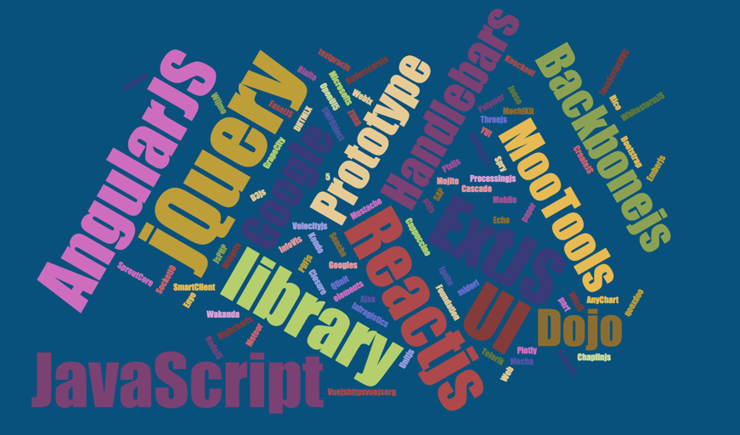
Oh great! another library !

Slide 3
Why should I learn D3?

Slide 4
Let’s Checkout Some Awesome examples
http://www.nytimes.com/interactive/2012/02/13/us/politics/2013-budget-proposal-graphic.html
https://braid.io/tile/wef-attendees-2016
http://digvijayu.github.io/scatter_map/
http://digvijayu.github.io/corpu_search/

Slide 5
What the hell is D3?
D3 allows you to bind arbitrary data to a Document Object Model (DOM), and then apply data-driven transformations to the document. For example, you can use D3 to generate an HTML table from an array of numbers. Or, use the same data to create an interactive SVG bar chart with smooth transitions and interaction.

Slide 6
Let’s start with basics

Slide 7
D3 for DOM Manipulation
It makes things like HTML document manipulation, event handling, animation, and Ajax much simpler with an easy-to-use API that works across a multitude of browsers.

Slide 8
Selecting Elements
d3.selection - select the root document element.
d3.select - select an element from the document.
d3.selectAll - select multiple elements from the document.
selection.select - select a descendant element for each selected element.
selection.selectAll - select multiple descendants for each selected element.
selection.filter - filter elements based on data.
selection.merge - merge this selection with another.
d3.matcher - test whether an element matches a selector.
d3.selector - select an element.
d3.selectorAll - select elements.

Slide 9
Modifying Elements
selection.attr - get or set an attribute.
selection.classed - get, add or remove CSS classes.
selection.style - get or set a style property.
selection.property - get or set a (raw) property.
selection.text - get or set the text content.
selection.html - get or set the inner HTML.
selection.append - create, append and select new elements.
selection.insert - create, insert and select new elements.
selection.remove - remove elements from the document.
selection.sort - sort elements in the document based on data.
selection.order - reorders elements in the document to match the selection.

Slide 10
3 little circles

Slide 11
Data Joins
Enter - incoming elements, entering the stage.
Update - persistent elements, staying on stage.
Exit - outgoing elements, exiting the stage.

Slide 12
Data Joins
Data
Elements
Enter
Update
Exit

Slide 13


